Slide 1


Analyzing Trend of Listing in Bangkok Between 2015-2022
Purwadhika Digital Technology School
Sulthanur Iman Fatahillah JCDS-2702
Notes:
Hello everyone. My name is Sulthanur Iman Fatahillah, and I’m excited to present my analysis titled “Analyzing Trends of Listing in Bangkok Between 2015–2022.”
This project is part of the bootcamp program from Purwadhika Digital Technology School.
Let’s dive into the world of Airbnb data and uncover patterns behind one of Southeast Asia’s busiest tourist cities.

Slide 2

Background
Bangkok has become one of Southeast Asia’s most visited cities, attracting millions of tourists annually.
The rapid growth of short-term rental platforms like Airbnb has significantly influenced the city’s hospitality landscape.
As tourism flourishes, understanding patterns in Airbnb usage is crucial for hosts, investors, policymakers, and platform managers
to ensure sustainable and profitable participation.
Sulthanur Iman Fatahillah
Purwadhika Digital Technology School
Notes:
Bangkok has become one of the most visited cities in Southeast Asia, drawing millions of tourists each year.
Platforms like Airbnb have played a significant role in transforming the hospitality landscape of the city.
With tourism booming, understanding how listings behave across time and neighborhoods is essential — whether you’re a host, investor, or policymaker — to ensure long-term success and sustainability.

Slide 3

Problem Statement
Despite the platform’s popularity, there is a lack of structured insight into how Airbnb listings in Bangkok perform across neighborhoods,
price ranges, room types, and host behaviors.
Without this understanding, stakeholders may struggle with inefficient pricing strategies, overlooked district opportunities,
and poorly optimized guest experiences.
Sulthanur Iman Fatahillah
Purwadhika Digital Technology School
Notes:
Despite Airbnb’s growing popularity, there’s a gap in structured insights.
We don’t have a clear understanding of how listings perform in different neighborhoods, price categories, or room types.
Without this, decision-makers risk applying inefficient pricing strategies, overlooking potential districts, or offering poorly optimized guest experiences.

Slide 4

Key Objective
Distribution of listings and reviews across neighborhoods.
Price range preferences of guests.
Temporal patterns in reviews (seasonality and COVID-19 impact).
Popularity of different room types.
Identification of top-performing hosts based on listing volume.
Sulthanur Iman Fatahillah
Purwadhika Digital Technology School
Notes:
This analysis focuses on five main objectives:
1. Exploring the distribution of listings and reviews across Bangkok’s districts.
2. Understanding price range preferences among guests.
3. Analyzing time-based patterns, including the impact of COVID-19.
4. Identifying the popularity of different room types.
5. Highlighting top-performing hosts based on the number of listings.

Slide 5

Data Preparation
Data Collection
Airbnb listing data was obtained from: https://www.kaggle.com/datasets/minemartin/bangkok-airbnb-listings/data
Bangkok district boundaries were sourced from: https://www.kaggle.com/datasets/soeltanpasja/bangkok-districts
Data Wrangling
Handled missing values
Removed unnecessary columns
Created new relevant columns
Managed outliers and data anomalies
Removed duplicated data
Sulthanur Iman Fatahillah
Purwadhika Digital Technology School
Notes:
The analysis involved two main steps:
First, Data Collection:
• Listing data was sourced from Kaggle’s Bangkok Airbnb dataset.
• District boundaries were taken from a separate geoJSON dataset, also from Kaggle.
Second, Data Wrangling:
• I cleaned missing values, removed unnecessary columns, created new fields such as Year and Month.
• Outliers and data anomalies were managed carefully.
• Duplicated data was also removed to ensure consistency and accuracy.

Slide 6

Data Analysis
Sulthanur Iman Fatahillah
Purwadhika Digital Technology School
Notes:
Let’s now move into the core of this project: Data Analysis.
Here, I’ve explored the dataset across various dimensions using both Python and Tableau.

Slide 7
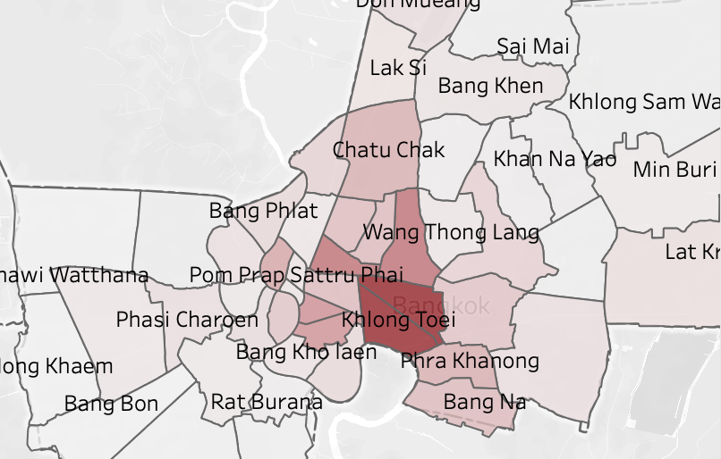
Distribution of Listing by Neighbourhood
1. Districts like Watthana, Khlong Toei, and Ratchathewi have the highest number of Airbnb listings, driven by tourist demand and accessibility.
2. Many outer districts have very few listings despite having infrastructure, showing opportunities for market expansion.
Sulthanur Iman Fatahillah
Purwadhika Digital Technology School
Notes:
Bangkok’s central districts such as Watthana, Khlong Toei, and Ratchathewi dominate in total listings.
This is expected, as they’re key tourist hubs with better accessibility.
However, outer districts show underutilized potential, especially areas that already have supporting infrastructure but minimal Airbnb activity.
This suggests a clear opportunity for growth outside the city center.

Slide 8
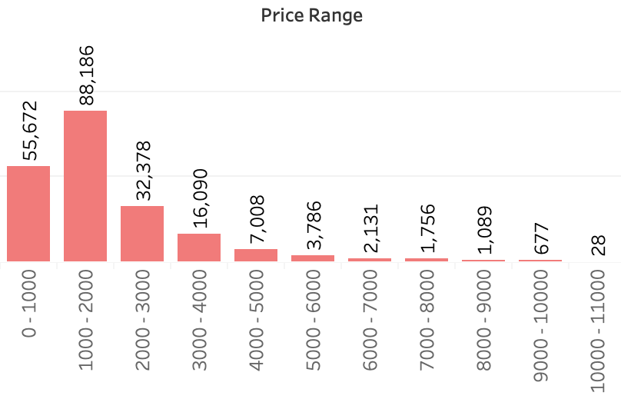
Ideal Price Range Based on Number of Reviews
1. Listings priced between 0–2000 Baht dominate in review counts, indicating that budget to mid-range accommodations are the most popular among users.
2. Listings priced above 5000 Baht received very few reviews, suggesting limited demand or low booking frequency in the premium segment.
Sulthanur Iman Fatahillah
Purwadhika Digital Technology School
Notes:
When analyzing review counts by price range, we see the highest engagement in the 0–2000 Baht range.
This shows guests heavily favor budget to mid-range stays.
On the other hand, listings priced above 5000 Baht attract very few reviews, possibly due to limited demand or exclusivity.
The takeaway: price sensitivity is high, and optimizing for value is key.

Slide 9
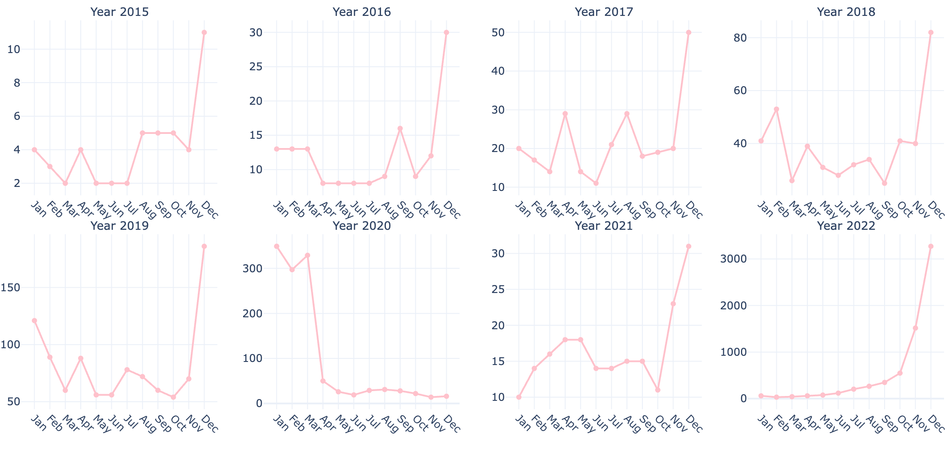
Monthly Last Review Count By Year
Year-End Review Spikes Reviews consistently peak in November–December, likely due to holiday seasons and tourist travel surges, especially visible in 2019 and 2022.
COVID-19 Impact in 2020. A sharp decline in reviews began in March 2020, caused by global lockdowns and travel bans, with low activity persisting through the year.
Sulthanur Iman Fatahillah
Purwadhika Digital Technology School
Notes:
Reviewing monthly trends, a pattern emerges:
Review counts consistently spike during November and December, likely tied to global holidays and year-end travel.
But in 2020, the COVID-19 pandemic disrupted this rhythm — reviews sharply declined after March due to lockdowns and travel bans.
This comparison highlights both seasonal trends and external impact.

Slide 10
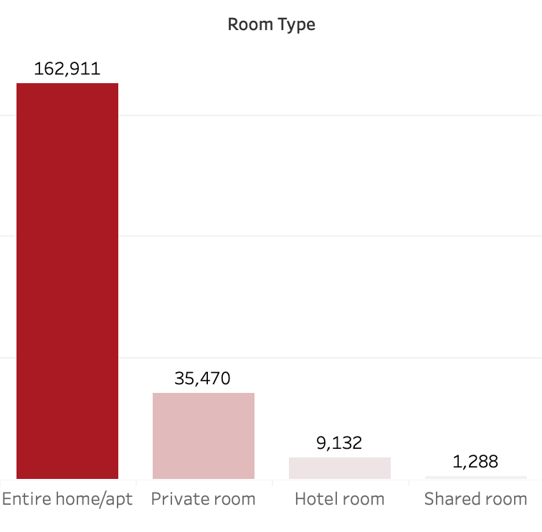
Total Number of Reviews by Room Type
The Entire home/apt room type received totaling nearly 200,000 reviews. This indicates a strong guest preference for private, fully rented accommodations.
While Private room is the second most reviewed category, it only accounts for about 25% of the reviews compared to Entire home/apt, highlighting a significant demand gap.
Hotel room and Shared room types received very few reviews, suggesting they are either less available or less popular among guests.
Sulthanur Iman Fatahillah
Purwadhika Digital Technology School
Notes:
Guests clearly prefer Entire home/apt options, which received nearly 200,000 reviews.
This room type offers privacy and flexibility — ideal for tourists or families.
Meanwhile, Private rooms came second but only earned a quarter of those reviews.
Hotel rooms and Shared rooms received very little attention, suggesting a niche or declining appeal.

Slide 11
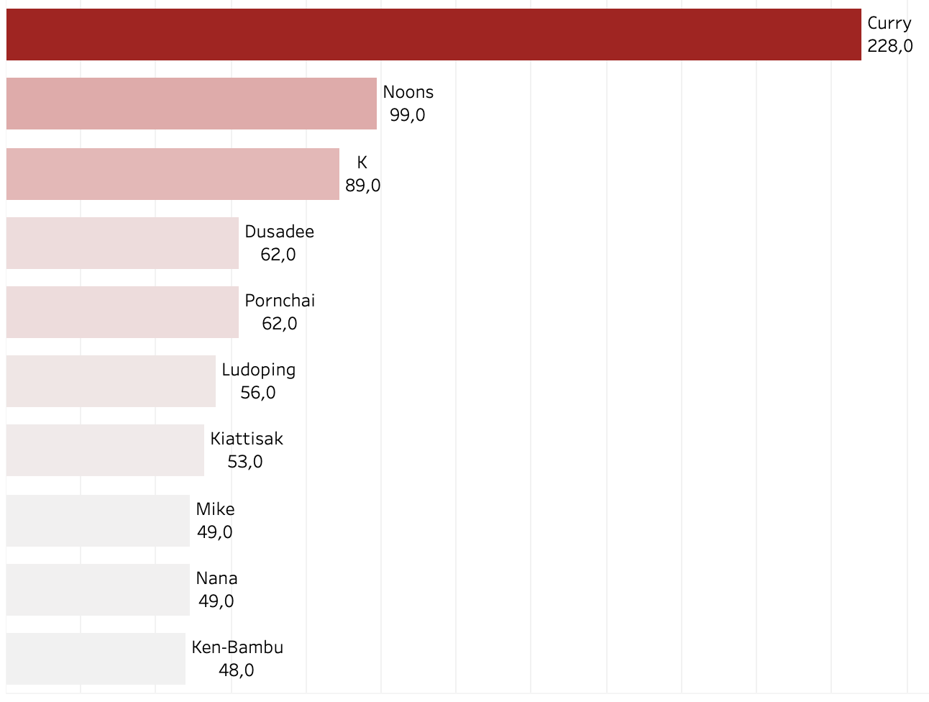
Super Host
Such hosts are likely operating as professional property managers or agencies rather than individuals.
This centralization could have implications on pricing, availability, and user experience in the platform.
Sulthanur Iman Fatahillah
Purwadhika Digital Technology School
Notes:
Here, I identified top hosts with the highest number of listings.
The leader, Curry, operates over 220 listings — followed by Noons, K, and others.
These hosts likely act as property managers or businesses, rather than individuals.
This trend points toward centralized listing ownership, which may influence the platform’s dynamics in pricing and availability.

Slide 12
Conclusion and Recommendations
Sulthanur Iman Fatahillah
Purwadhika Digital Technology School
Notes:
Now let’s move into the conclusion and key takeaways from this study.

Slide 13

Key Insights
Central districts dominate in listing counts, but outer districts show growth potential.
Reviews peak toward the year-end, especially in November–December, driven by tourism seasons.
Budget to mid-range prices (0–2000 Baht) attract the most guest engagement.
Entire home/apt listings are vastly preferred over other room types.
A small number of professional hosts manage a large share of listings, indicating market centralization.
Sulthanur Iman Fatahillah
Purwadhika Digital Technology School
Notes:
1. Central districts dominate in listing counts — but outer districts still hold untapped growth potential.
2. Reviews spike toward the year-end, especially November–December.
3. Budget listings under 2000 Baht gain the most guest engagement.
4. Guests overwhelmingly prefer Entire home/apt options over shared spaces.
5. A small number of high-volume hosts manage a significant portion of listings, showing clear market concentration.

Slide 14

Take Action
Encourage listing growth in underserved but accessible areas to reduce competition and expand guest options.
Promote listings more heavily between October–December with tailored offers to maximize visibility and bookings.
Improve amenities, descriptions, and pricing strategies for listings in the 1000–2000 Baht range.
Invest more in entire apartments/homes, as guests clearly favor privacy and autonomy.
Work closely with high-volume hosts to maintain platform quality, ensure regulatory compliance, and gather best practices to support new hosts.
Build adaptive strategies for listings to cope with external events like pandemics through long-stay options, flexible bookings, and localized marketing.
Sulthanur Iman Fatahillah
Purwadhika Digital Technology School
Notes:
Based on these findings, here are some recommendations:
• Expand into underrepresented but accessible districts to reduce saturation and grow supply.
• Boost listing promotions between October and December to align with peak demand.
• Focus on enhancing listings priced between 1000–2000 Baht to improve competitiveness.
• Invest in entire apartment listings, aligning with guest preferences.
• Build partnerships with top hosts while ensuring quality and compliance.
• Lastly, prepare for future disruptions by enabling long-term stays and adding flexibility to booking options.

Slide 15


Thank You
https://github.com/sulthanfatahillah12
https://www.linkedin.com/in/sulthanur-iman-fatahillah
Sulthanur Iman Fatahillah
Purwadhika Digital Technology School
Notes:
Thank you for your attention!
You can find more of my work on GitHub and connect with me on LinkedIn.
I look forward to discussing any feedback or questions you might have.
bye-bye

